Slide 1
Intranet Mailing System
Name: Lovely Kumari Singh
Roll No. 1402714021

Slide 2
Introduction
“Intranet Mailing System” has been developed out of a need for communation between the Employees of the organization and their colluges. “Intranet Mail System” provides a means by which employees can place their queries and message, reply to each others quires, send each others mails and basically keep in touch across the network.
This document is an overall description of the requirement for an “Intranet Mail System” to be implemented in an organization.
This “Intranet Mail System” will fulfill all tha organizational needs of the employees as well as the clients in a user friendly and an efficient manner overcoming the shortcomings of the current manual system to a major extent.
This would be a web based application that would provide a single platform for all the employees or users of an organization sitting at different locations to interact with each oter and make a community for messaging, blogs, forums, reports and query. It helps in making the communication faster and easier.

Slide 3
It will manage all the departments, roles, employees and all the queries of the users.The different employees of the organizations can easily send messages to each other and intract. They even upload their daily activity reports, weekly activity reports and monthly activity reports.

Slide 4
Company Profile
Ducat:
Ducat, Noida was established in 2001. DUCAT offers a wide spectrum of technical courses and application courses designed to suit every skill level, as well as the ability to consult directly with organizations to tailor made learning plans for any number of employees. The institute products and services have a wide appeal and are applicable those in varied positions including network administrators, systems analysts, systems architects, test engineers, software developers, help desk staff, IT managers, senior executives, administrative assistants and business professionals.
The institute offering courses in Java Technology, IBM mainframe, C, C++, Red Hat Linux, SAS, Data warehousing, SQT, Microsoft Technology, SEO, VLSI Technology, Networking, PHP & PHP ++, Embedded Systems, Oracle, Cad etc. A variety of teaching and learning techniques are employed to impart knowledge and skills to the students in various courses of the institute.

Slide 5
Problem Discription
The manual work and message which is neccessary to convey to from one user to other can be manage easily and rapidly.
Like:
Sending some information via mail.
Communication of the user is now easy by using chat in the network.
Sending attachment of file via mail
All these work can be done rapidly and very easily.
Limitations
- User can only use this application from the computer which is connected toWAN.
- Only able to handle restricted Category range.
- If the Main Server has some problem user has to wait till it solve to user application.

Slide 6
SYSTEM IMPLEMENTATION
Hardware Requirement:-
Processor Pentium 4th
RAM 128MB
Hard Disk 20GB/40GB.
Display SVGA(800X600 Resolution)
Software Requirement:-
Operating System Windows 98/2000/XP,Unix,Linux
Front End Html/Servlet/JSP.
Back End MySql.
Design Patterns MVC.

Slide 7
TOOLS/PLATFORM USED:
Front End
Servlet/Java Server Pages
    User friendly
    GUI
    Separation of work (designing & coding)
    Written once run anywhere
    Middle-Tier
    Java Beans.
Back End
Oracle/MySql
        Security
        Performance
        Scalability
        Reliability

Slide 8
Modules & Process Logic of Project
Administrator:
In Administrator module we have five options:
Check Mail.
Send Mail.
View User.
Search User.
Delete User.

Slide 9
2. User:
In user module we have six options.
Send Mail.
Check Mail.
Generate Contact.
Delete Contact.
View Contact.
Search Contact.
When the user selects the “Send Mail” option, then the form will be opened for sending mail. Then the user can send mail to any user who has a user id in the organization.

Slide 10
4. Login:
In this module User enter the User id and password is checked and only valid user id and password will get entry into member’s zone. This is a security feature to avoid entry of unauthorized users.
5 Write Mail
You can write any mail and also attach any document or image and send to your destinations. You can write any mail and also attach any document or image and send to your destinations.

Slide 11
Signup details: This table contains signup details .
Modules and Table
Field Name | Null? | Data Type
Uname | NOT NULL | Varchar(50)
Passwd |  | Varchar(30)
Age |  | Int
Sex |  | Varchar(6)
City |  | Varchar(50)
State |  | Varchar(50)
Pin |  | Varchar(20)
Country |  | Varchar(40)

Slide 12
Chat Message: This table maintains date of message.
Field Name | Null? | Data Type
Username | NOT NULL | Varchar2(40)
Message |  | Varchar2(40)
Date |  | Varchar2(30)
Response_id |  | Int
Response_text |  | Varchar2(99)
Login: This stores the users login id
Field Name | Null? | Data Type
Username | NOT NULL | Varchar2(40)
Password |  | Varchar2(40)

Slide 13
Data flow Diagram
The Data flow Diagram shows the flow of data. It is generally made of symbols given below:
(1) A Rectangle shows the Entity: -
(2) A Circle shows the Process: -
(3) An open Ended Rectangle shows the data store: --
(4) An arrow shows the data flow:-
The DFD can be up to several levels. The 0 level DFD states the flow of data in the system as seen
from the outward in each module.
The first level DFD show more detail, about the single process of the 0 level DFD
The second level DFD can show even more details and so on.

Slide 14
0 Level DFD
ADMIN
SEARCH
REGISTRATION/PROFILE
User
VIEW CONTACTS
LOGIN
Intranet mail system
SEND MAIL
SEND MAIL
VIEW MAIL
CHAT
SEND RESPONSE
VIEW RESPONSES

Slide 15
FIRST LEVEL DFD
Mail in queue
ADMINISTRATOR
WRITE MAIL
1.0

Slide 16
Message
ADMIN
CHAT
3.0
USER

Slide 17
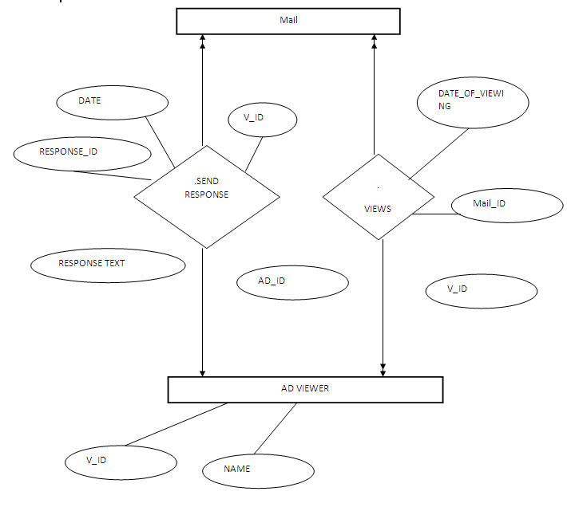
ENTITY RELATIONSHIP
DIAGRAM
An entity-relationship (ER) diagram is a specialized graphic that illustrates the interrelationships between entities in a database. ER diagrams often use symbols to represent three different types of information. Boxes are commonly used to represent entities. Diamonds are normally used to represent relationships and ovals are used to represent attributes.

Slide 18
Input of the project
Login page get the input of user id and password.
Create the new user id for your Profile yourself.
Compose mail.
Attach the file with mail.
View responses.
Change password
Search
chat
Output of the project
View Chat.
Message Inbox.
Help
Home

Slide 19
Report
In the Intranet Mail System there are a number of formats in which the reports can be generated. The names and grabs of some of the reports that can be generated are as follows -
Mail detail categry wise
Search category wise
Compose detail
Process detail
Attachment detail
Feedback detail
Avilabelety detail
The project titled as “Intranet Manager” is a web based application. The application is built to perform and deliver the best in terms of:
Ease of operations
Completeness, as judged by the employee(the organization)
Efficiently delivering – “what is required”?
Adaptability to required changes and updating

Slide 20
This software has been developed with scalability in mind. Additional modules can be easily added when necessary. The software is developed with modular approach. All modules in the system have been tested with valid data and invalid data and everything work successfully. Thus the system has fulfilled all the objectives identified and is able to replace the existing system.
The project has been completed successfully with the maximum satisfaction of the organization. The constraints are met and overcome successfully. The system is designed as like it was decided in the design phase. The project gives good idea on developing a full-fledged application satisfying the user requirements.
The system is very flexible and versatile. This software has a user-friendly screen that enables the user to use without any inconvenience. Validation checks induced have greatly reduced errors. Provisions have been made to upgrade the software. The application has been tested with live data and has provided a successful result. Hence the software has proved to work efficiently.
The project has been completed successfully with the maximum satisfaction of the organization. The constraints are met and overcome successfully. The system is designed as like it was decided in the design phase. The project gives good idea on developing a full-fledged application satisfying the user requirements.
The system is very flexible and versatile. This software has a user-friendly screen that enables the user to use without any inconvenience. Validation checks induced have greatly reduced errors. Provisions have been made to upgrade the software. The application has been tested with live data and has provided a successful result. Hence the software has proved to work efficiently.

Slide 21
Conclusion
In the Intranet Mail System there are a number of formats in which the reports can be generated. The names and grabs of some of the reports that can be generated are as follows -
Mail detail categry wise
Search category wise
Compose detail
Process detail
Attachment detail
Feedback detail
Avilabelety detail
This software has been developed with scalability in mind. Additional modules can be easily added when necessary. The software is developed with modular approach. All modules in the system have been tested with valid data and invalid data and everything work successfully. Thus the system has fulfilled all the objectives identified and is able to replace the existing system.

Slide 22
Future Scope
The future scope of this project, Intranet mail system is very wide. There are many additional features, which are planned to be incorporated during the future enhancements of this project.
Although all the main objectives according to SRS document have been achieved but still there is room for enhancement.
This software can be easily upgraded in the future. And also include many more features for existing system.
It is connected to the network for easy retrival of data and many more location or many districts or cities in different states.
All the information can be easily accessed by the employee like their details, mails, departments. It can be modified and the other details can be easily provided to customer.
If anyone wants to combine all the departments of organization through internet then he can easily do this with the help of this technology called java.

Slide 23
References
Book
Java-2 Complete Reference - by Patrick Naughton
Java Servlet Programming - by O'Reilly
Pure JavaScript - by Jason Gilliam,Charlton Try, R.Allen Wyke
HTML complete - BPB publications.
Java Server Programming - by Apress publication.
SITES:
http://www.sun.com
http://www.coreservlets.com
http://www.serverside.com
http://www.w3schools.com

Slide 24
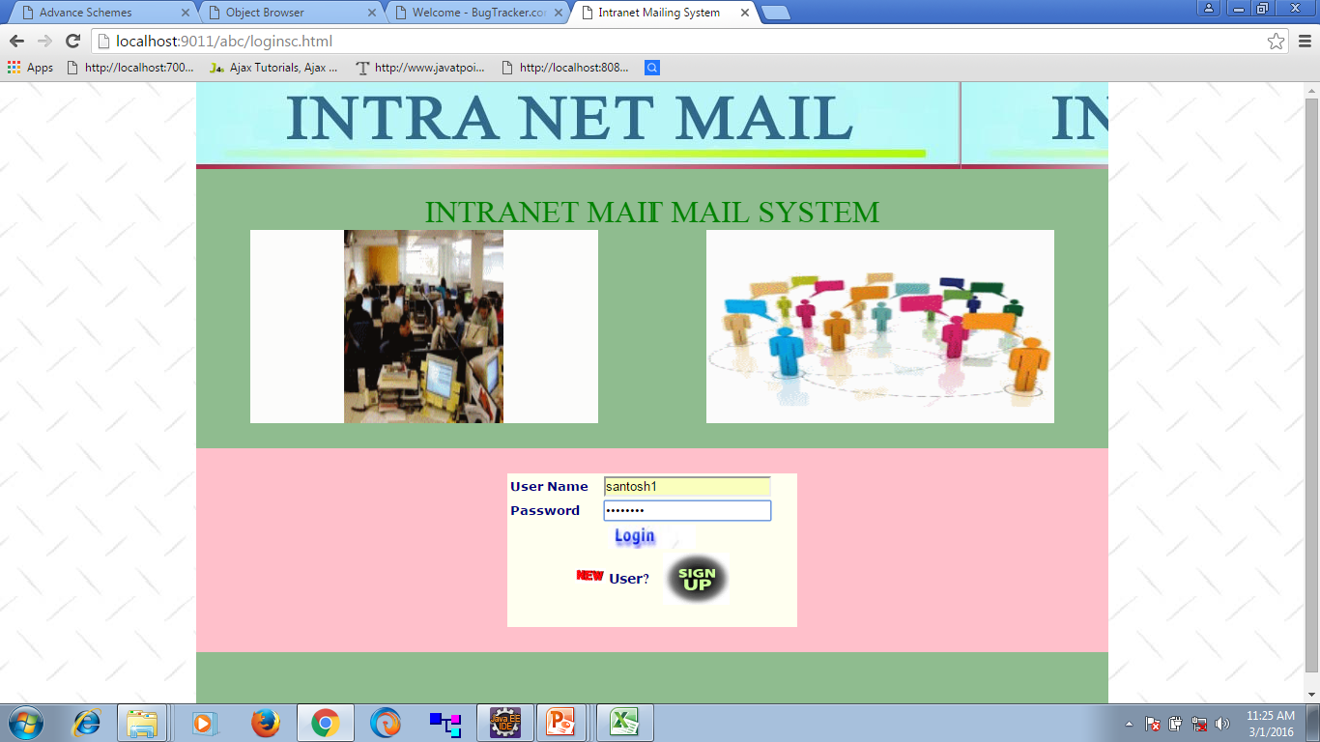

Slide 25
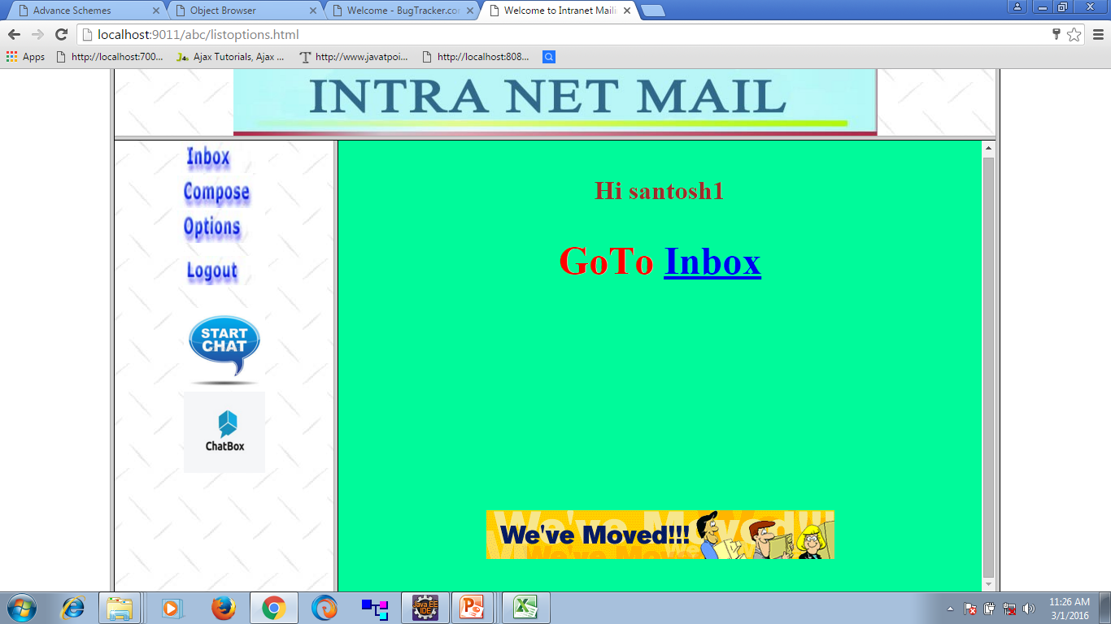

Slide 26
